Slide 1
IOT BASED SMART CROP SUITABILITY SYSTEM

Slide 2
Supervisor - Dr. Anuradha jayakody
Co- supervisor - Dr. Pradeep Abegunawardhana
Member | IT number
C.P. Wikramasinghe | IT16034600
H.P.H.S. Hemapriya | IT16102460
P.L.N. Lakshitha | IT16021594
P.G.N.S. Ranasinghe | IT16119772

Slide 3
Presentation content
Introduction and background
What are the difficulties people facing
related to cultivation?
Objectives
Features of android application
Business worth of the system

Slide 4
Introduction and Background
Information technology is rarely used in agricultural related activities in Sri Lanka.
Cultivators facing so many difficulties by using odd methods for certain things in this field.

Slide 5
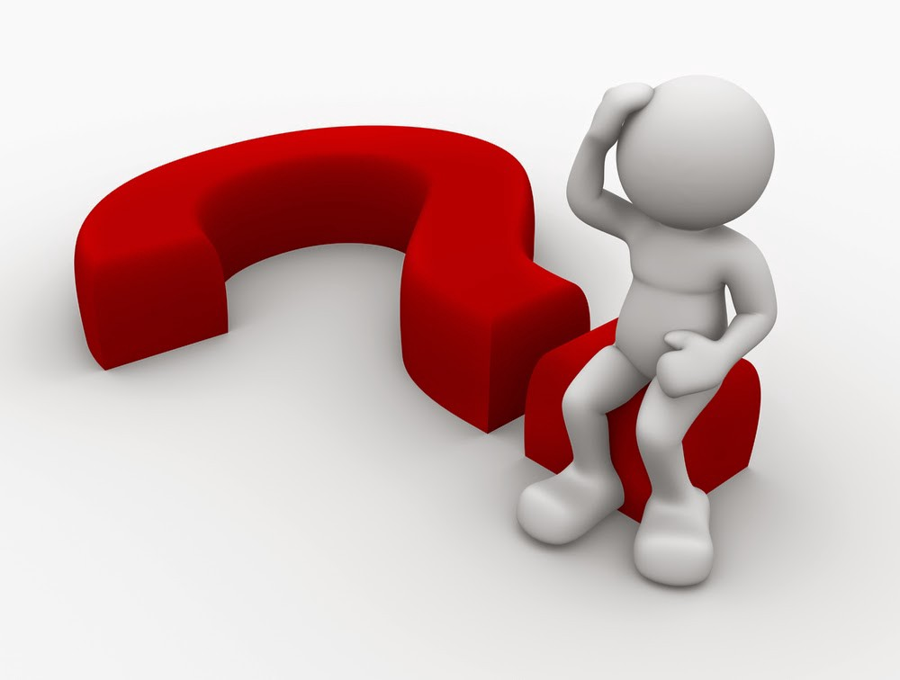
What are the difficulties people facing related to cultivation?

Slide 6
Selecting most suitable crops for their lands.
Use necessary amount of fertilizer a farmer should use to have best harvest.
Worrying about the yield going to be produced.
No idea about how to get good cultivation using fertilizer.

Slide 7
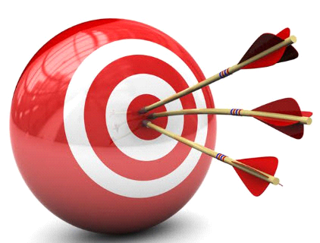
How can we solve them?
The objectives below will be implemented to overcome these problems.

Slide 8
To estimate fertility status of soil and can
easily identify the best crop that can plant
in that ground
Using the sensor readings and compare them with relevant data sets
we gather data sets to maintain best environment and fertility levels for main commercial crops such as tomato, chilies, papaya, banana, rubber, coconut and tea.

Slide 9
To change nutrient level in soil according to crop we need to grow. So, can gain good result
Can reduce the failure of plantations according to law and unbalance fertility level.
But with the relevant information farmers have more confidence to plant and they can check and maintain plantation with major stages of the crop in case of low growing.

Slide 10
To use by Any person to start their own plantation
Famers can start plantation without having any basic knowledge about the crops they going to plant. most of time and cost is reducing with the help of this method.
Suggest everything which necessary to plant the relevant crop.

Slide 11
To provide a basis for fertilizer recommendation for a given crop
Requirements of fertilizers for plants can be vary according to the stage of plant.
Farmers will get know what’s the exact fertilizers should give more in particular stages.

Slide 12
To Reduce the risk of not being able to have good result from plantations
Save the soil

Slide 13
To use by any person to start their own plantation
To Reduce the risk of not being able to have good result from plantations
To provide a basis for fertilizer recommendation for a given crop

Slide 14
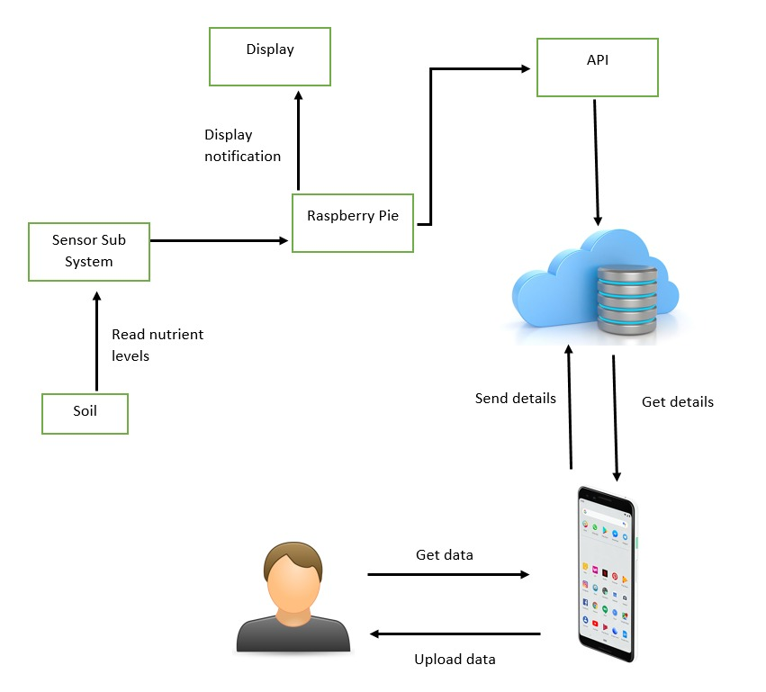
System Diagram

Slide 15
Features of Android Application
Predicting the best crop for a particular ground.
Generating the future fertilizer plan for the selected crop.
Pave the way for a better and easy way to have a successful cultivation.

Slide 16

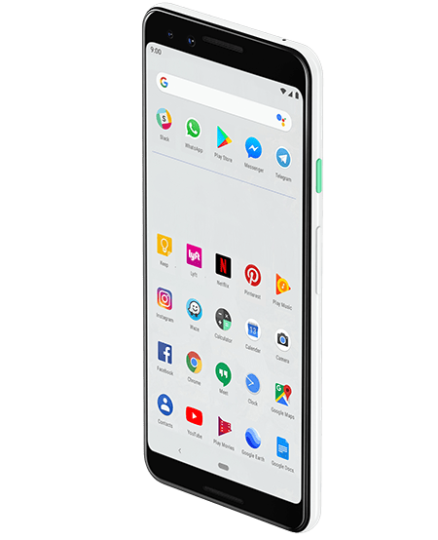
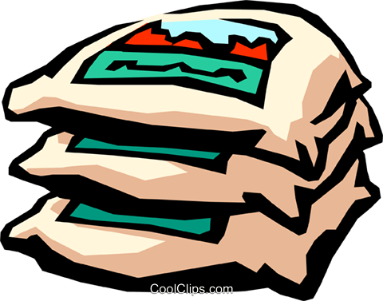


Final outcome
Recommend the best crop
Recommend the fertilizer usage
Suggest the future furyilizer plan

Slide 17
Business Worth of the System
Give range of predictions to the cultivators, that can be grown with existing nutrient levels in soil.
Recommend fertilizer plan to increase the profitability of the users.
Suggest future fertilizer plan to minimize risks.
Avoid loss of time and money.
New cultivator can start cultivations with less experience

Slide 18
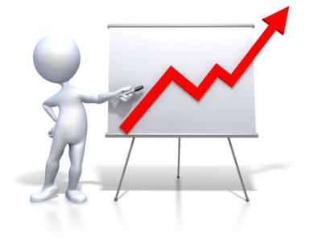
What is the market space?
Can use the application anywhere at anytime.
Cultivators can have the best profit with relevant to money they invest
Users can save both time and money.

Slide 19

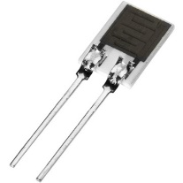
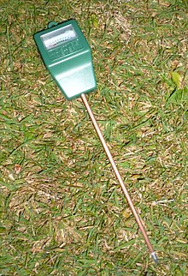

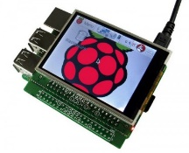

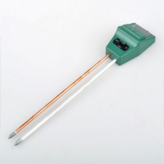
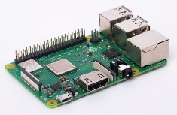
Hardware and Software Requirements
Software Requirements
Visual Studio 2017
Xamarin
MySQL
Hardware Requirements
Raspberry pi 3 Model B+
Sensors (pH, Electricity conductivity (ec), Humidity, Temperature)
LCD screen

Slide 20
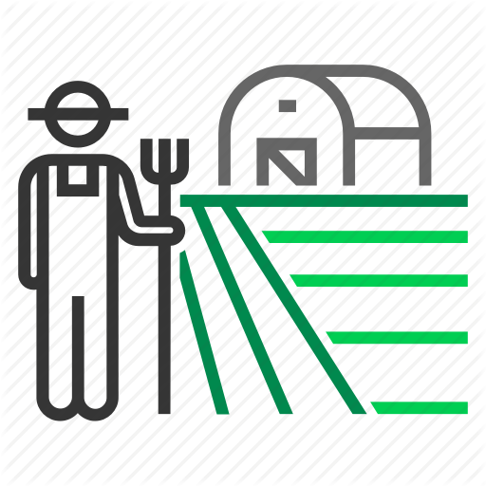

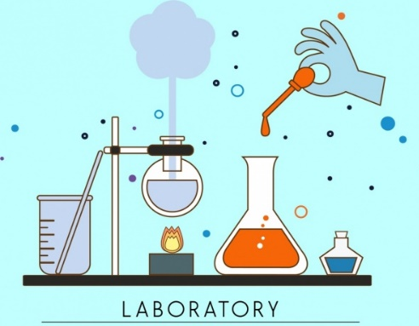
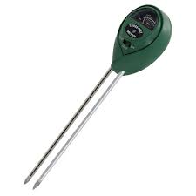
Selecting most suitable crops for specific lands.
Present system of soil testing
Take 2-3 months to lab test
Proposed system for soil testing
Take less than a minute

Slide 21
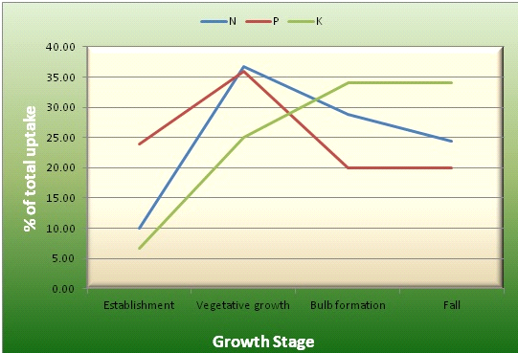
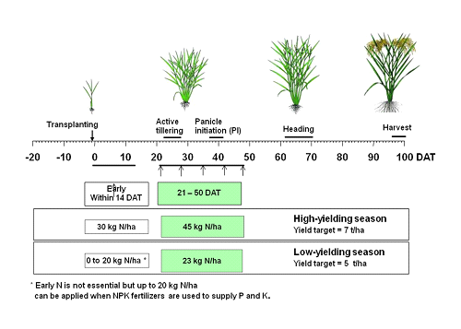
Crop stage level fertilizer prediction

Slide 22
Timing of fertilizer application has a significant effect on crop yields.
Proper timing of the fertilizer application increases yields, reduces nutrient losses, increases nutrient use efficiency and prevents damage to the environment.
Applying fertilizers at the wrong timing might result in nutrient losses, waste of fertilizer and even damage to the crop.

Slide 23

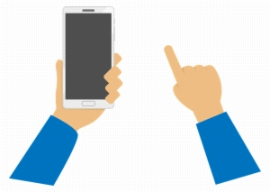

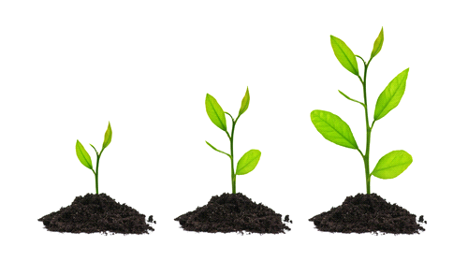
check the current stage of the plant(by height or other stage views such as flowering ,ripenning)
apply the stage level to the app
get the out put view of the recommend fertilizer level by app

Slide 24

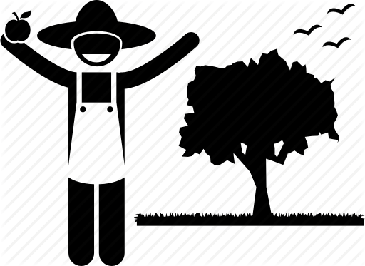
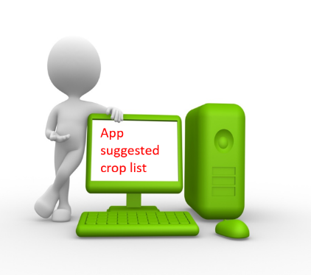
Module to suggest suitability of a requested crop with a fertilizer plan
How can I have best profit?
Fertilizers
suggestion
for better
harvest

Slide 25
Developing a co-relationship to recommend necessary amount of fertilizer needed for have better harvest.
Recommend suitability of the crop searched by the farmer in addition to crop suggested by the app.

Slide 26
Generating the fertilizer plan
Cloud storage for managing required data.
Analyze current data set and compare with the cloud data.
Generate the future fertilizer plan according to the current soil conditions.

Slide 27
THANK YOU

